Slide 1
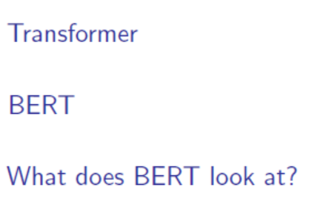
Transformer and BERT

Slide 2
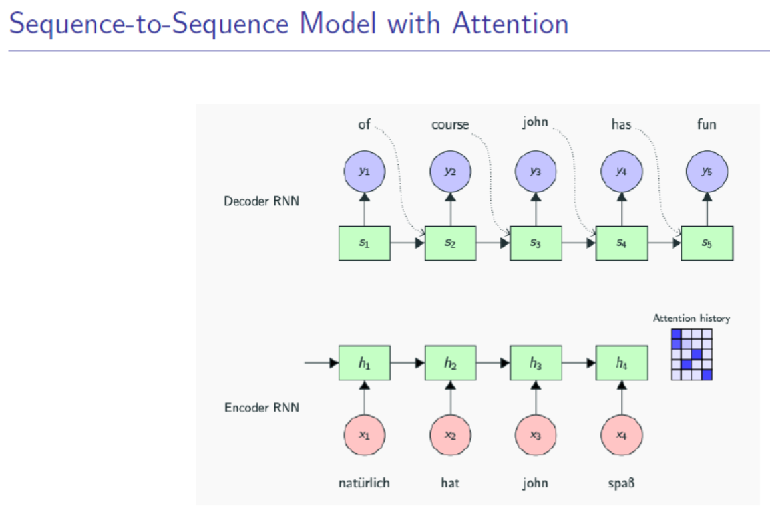

Slide 3
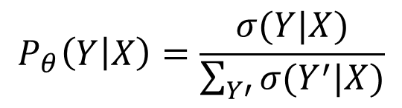
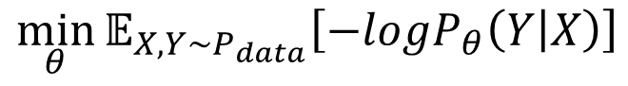
Maximum Likelihood Estimation
$$P_{θ}\left(Y | X\right)=\frac{σ(Y|X)}{\sum_{Y′}{σ(Y^{′}|X)}}$$
$$\min_{θ}{𝔼_{X,Y\sim P_{data}}\left[−logP_{θ}\left(Y | X\right)\right]}$$
Calculating partition function directly requires exponential time!

Slide 4
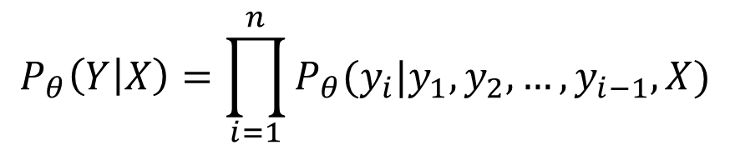
Maximum Likelihood Estimation
$$P_{θ}\left(Y | X\right)=\frac{σ(Y|X)}{\sum_{Y′}{σ(Y^{′}|X)}}$$
$$\min_{θ}{𝔼_{X,Y\sim P_{data}}\left[−logP_{θ}\left(Y | X\right)\right]}$$
Decompose the joint distribution
y₁
y₂
…
y_{n}
$$P_{θ}\left(Y | X\right)=\prod_{i=1}^{n}{P_{θ}(y_{i}|y_{1},y_{2},…,y_{i−1},X)}$$
Parameterize with RNN

Slide 5

Maximum Likelihood Estimation
$$P_{θ}\left(Y | X\right)=\frac{σ(Y|X)}{\sum_{Y′}{σ(Y^{′}|X)}}$$
$$\min_{θ}{𝔼_{X,Y\sim P_{data}}\left[−logP_{θ}\left(Y | X\right)\right]}$$
Decompose the joint distribution
y₁
y₂
…
y_{n}
$$P_{θ}\left(Y | X\right)=\prod_{i=1}^{n}{P_{θ}(y_{i}|y_{1},y_{2},…,y_{i−1},X)}$$
Parameterize with RNN

Slide 6
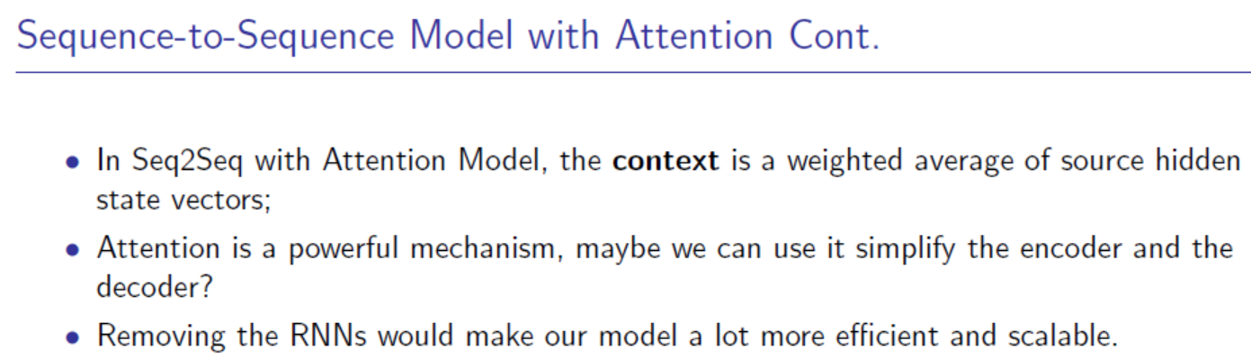

Slide 7
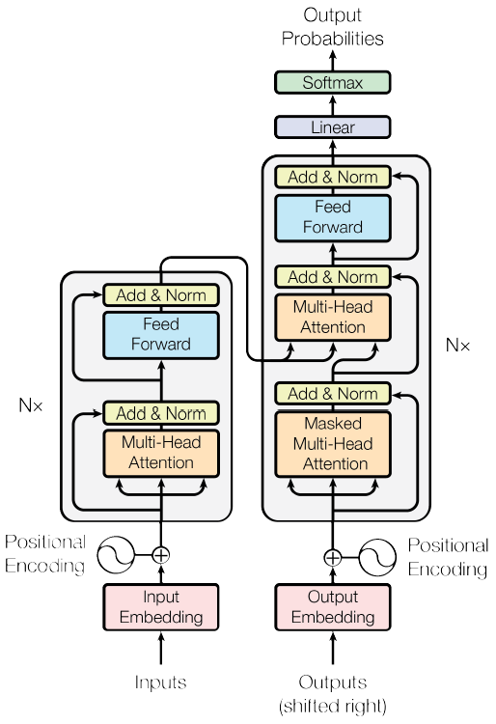
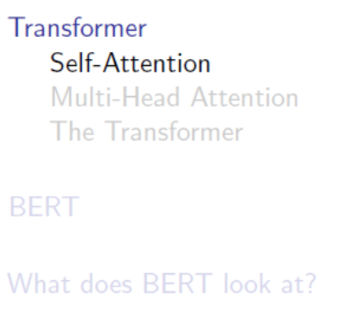
“Attention is All You Need”

Slide 8
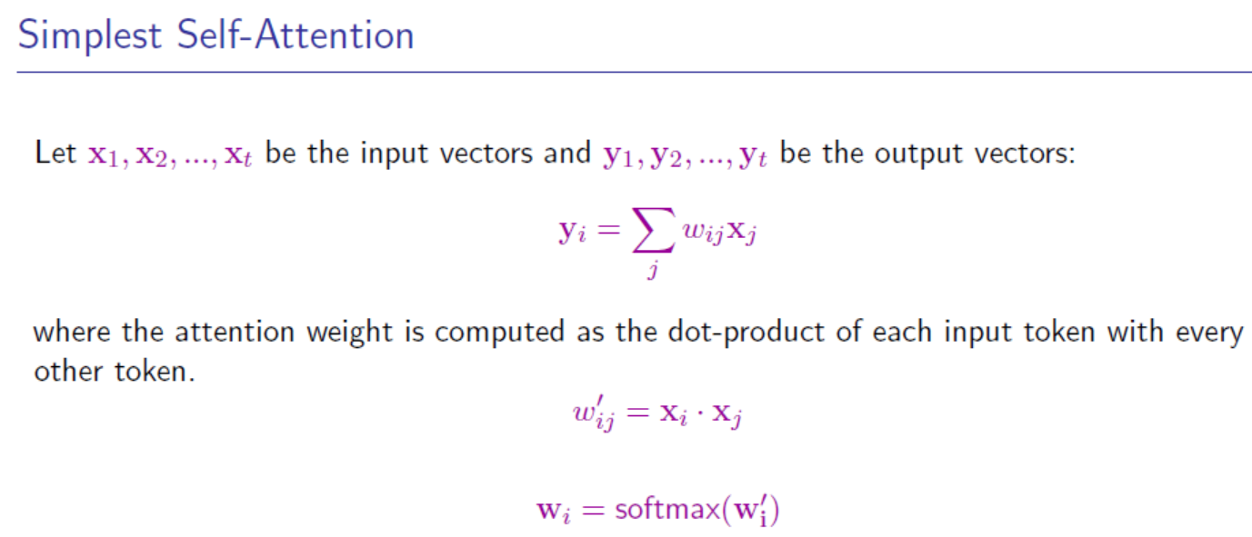

Slide 9
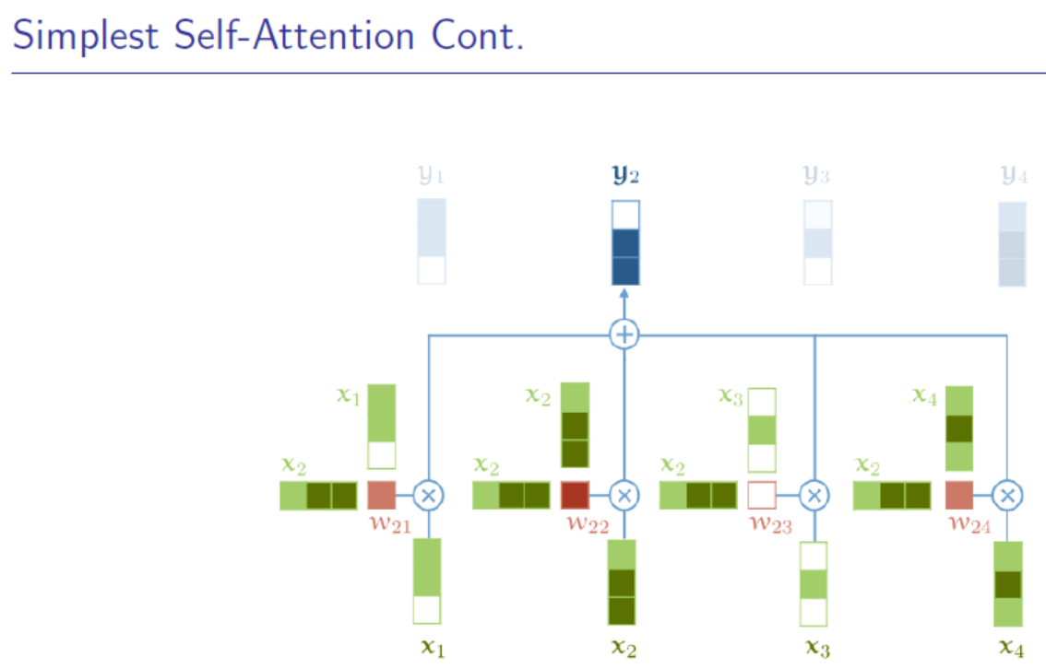

Slide 10
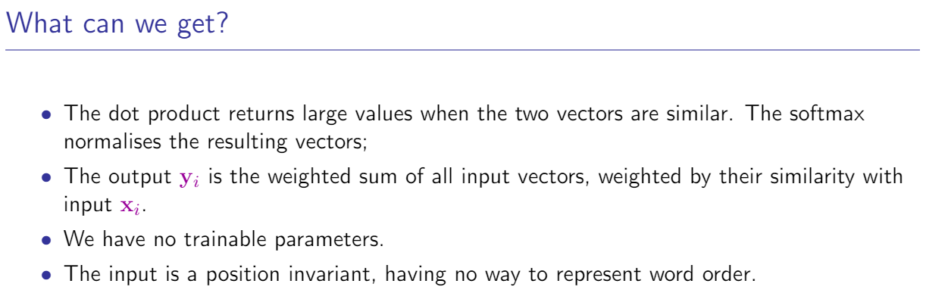

Slide 11
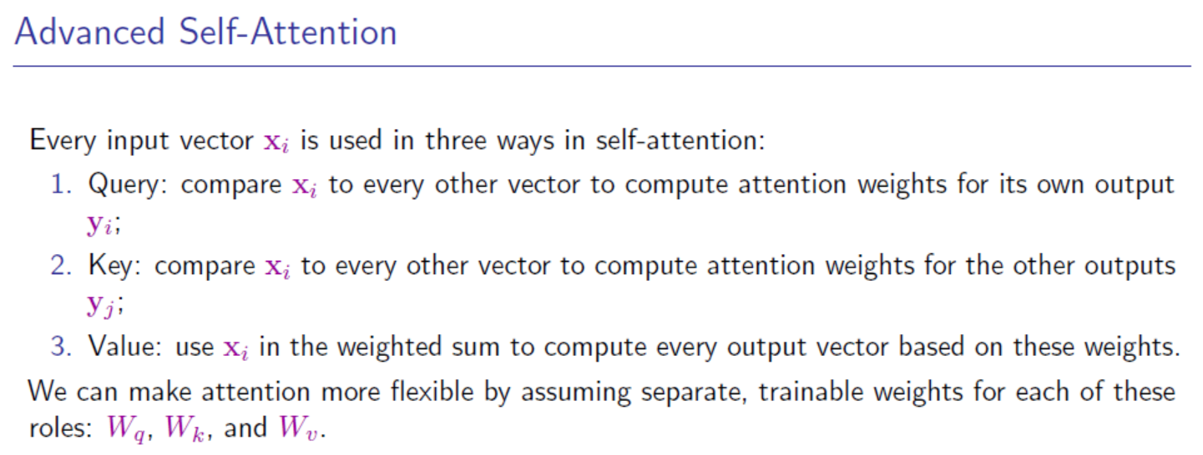

Slide 12
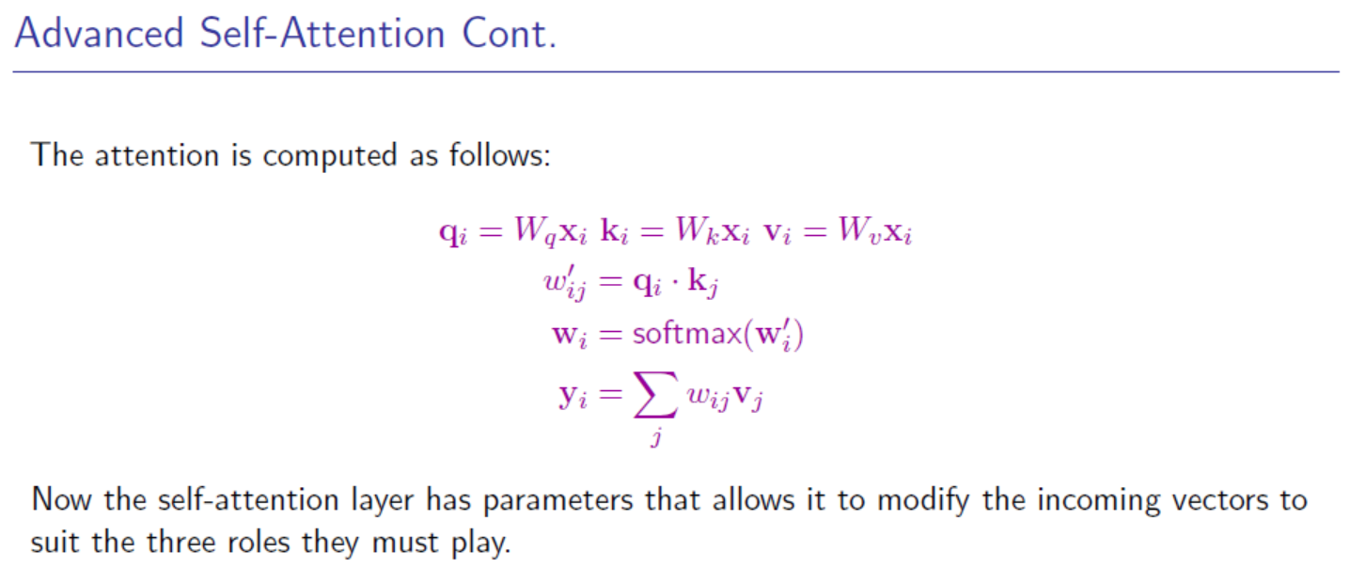

Slide 13
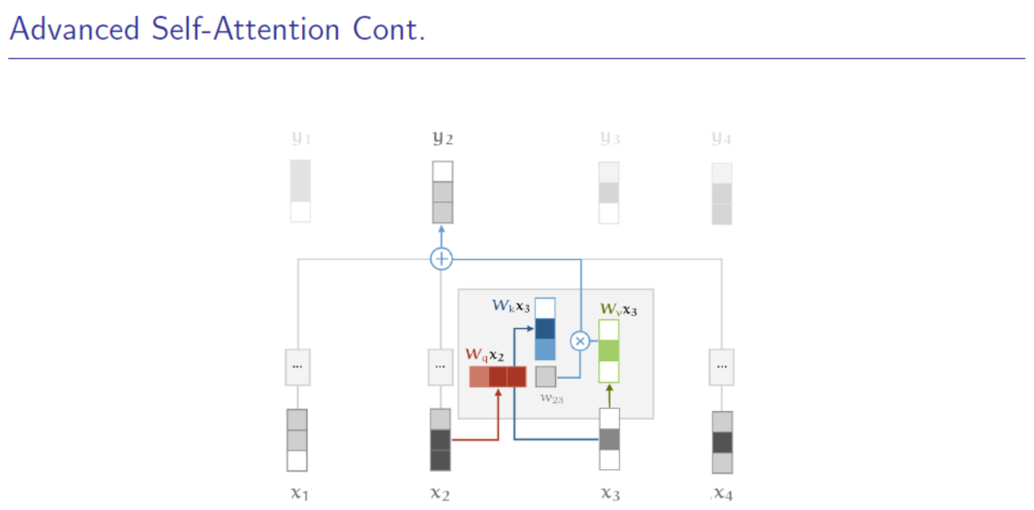

Slide 14
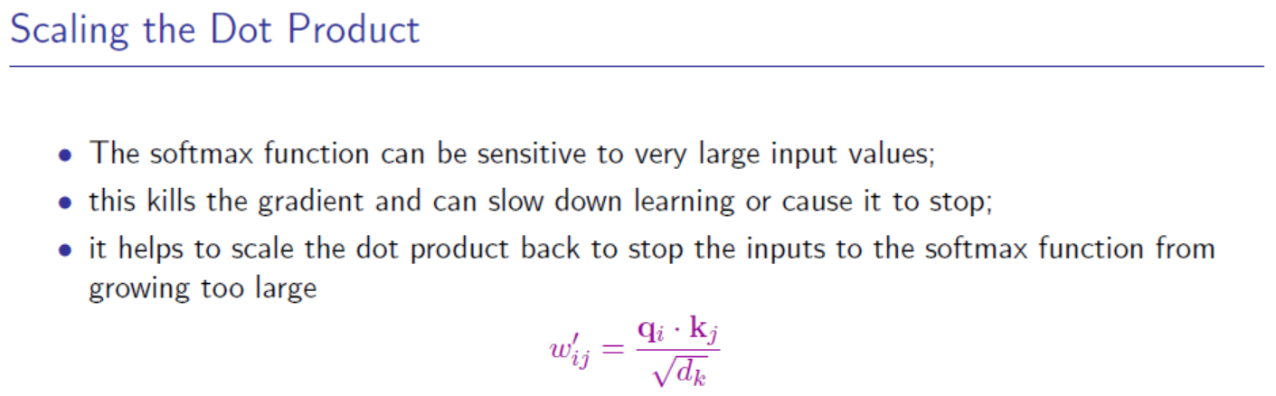

Slide 15
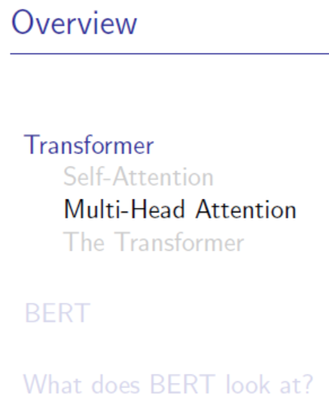

Slide 16
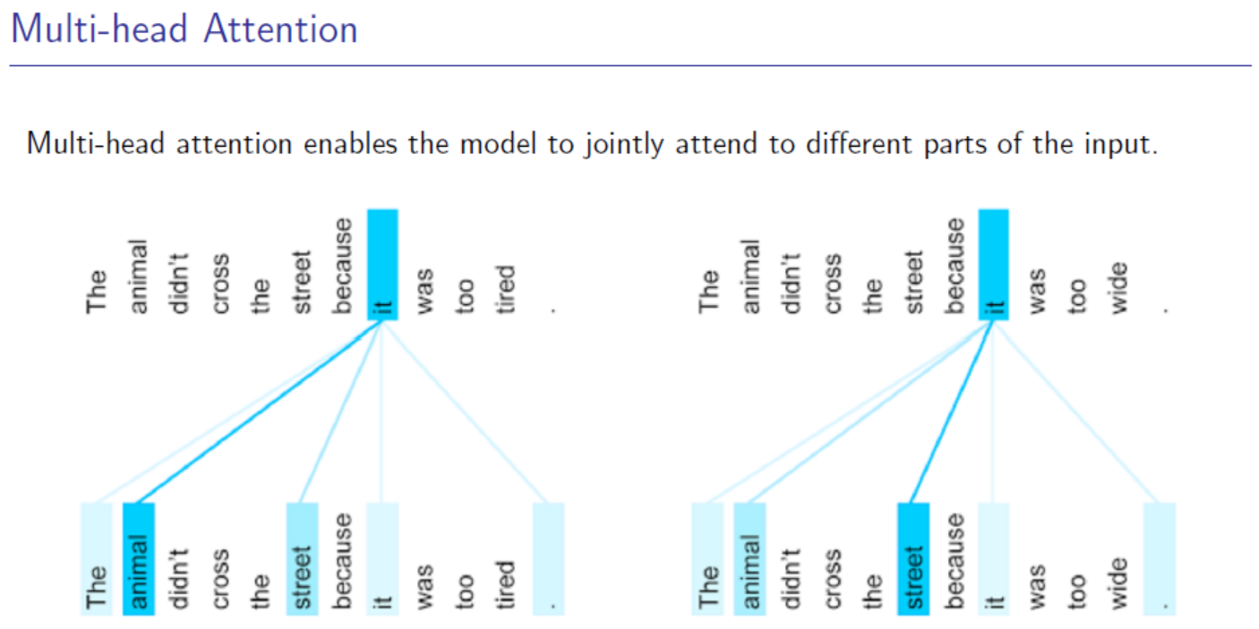

Slide 17
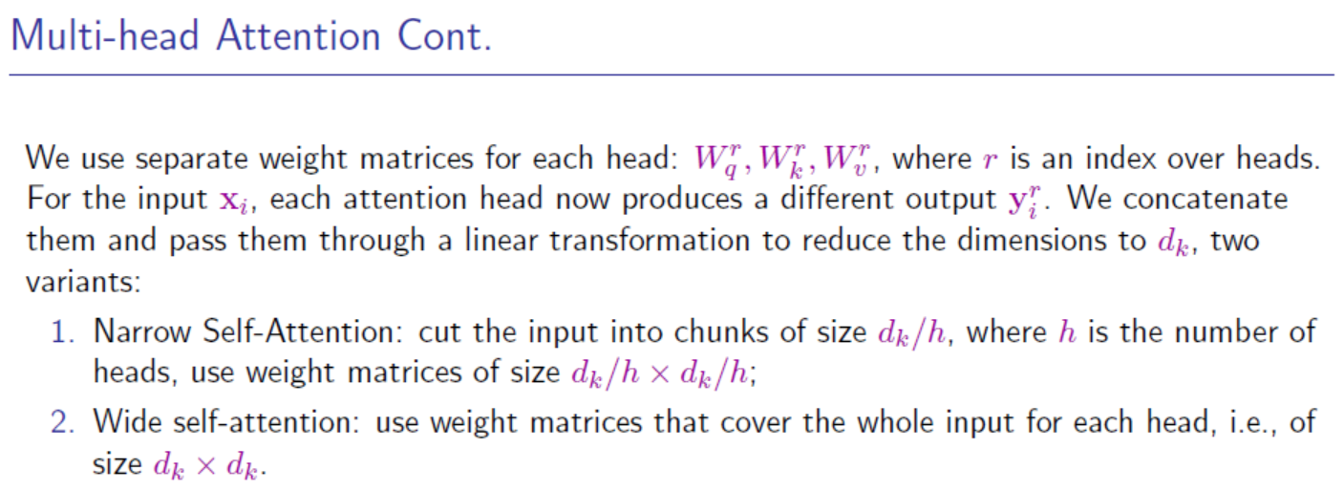

Slide 18
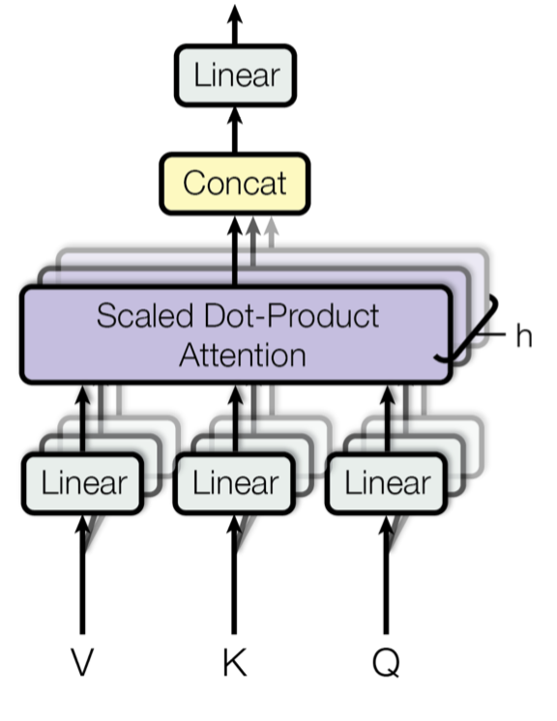

Slide 19
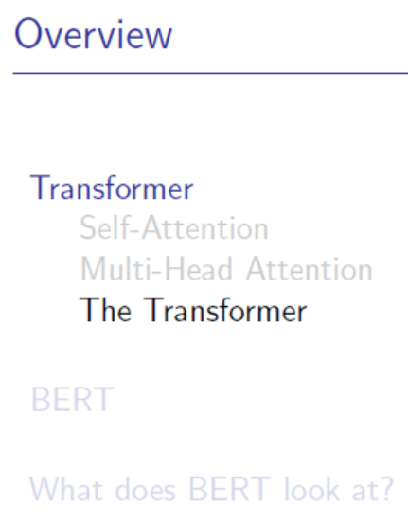

Slide 20
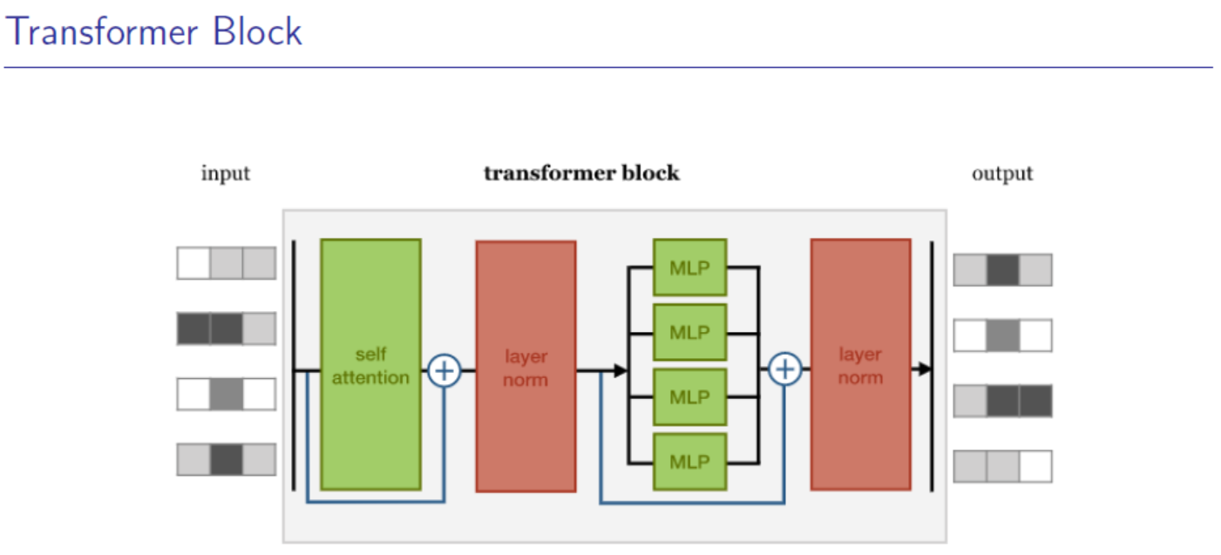

Slide 21
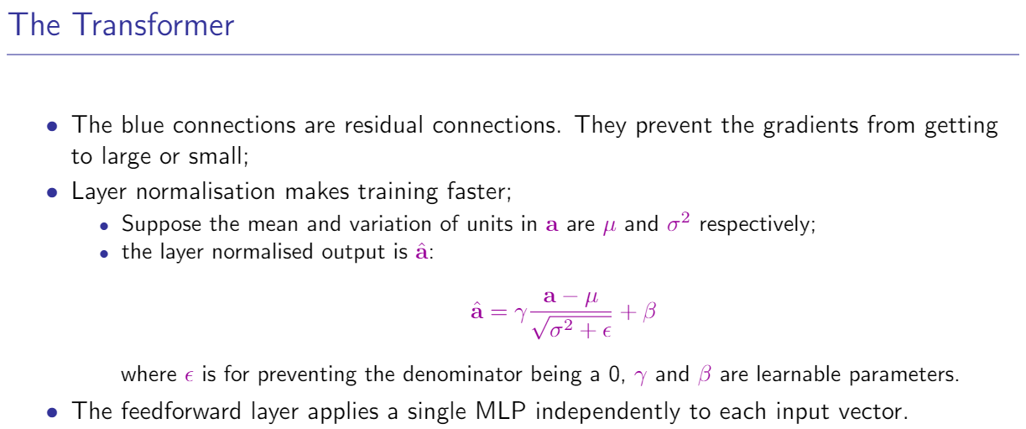

Slide 22
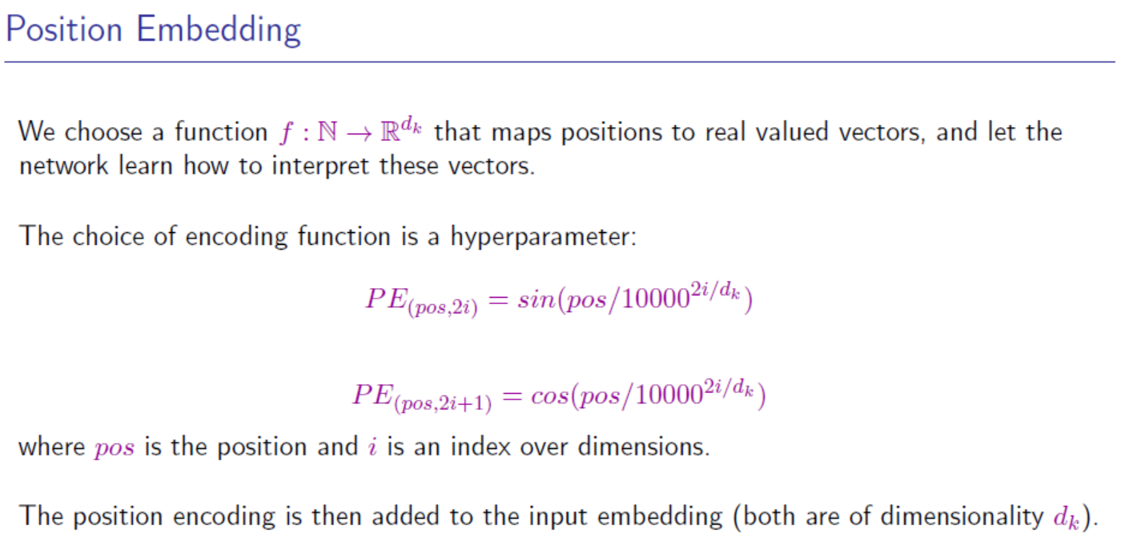

Slide 23
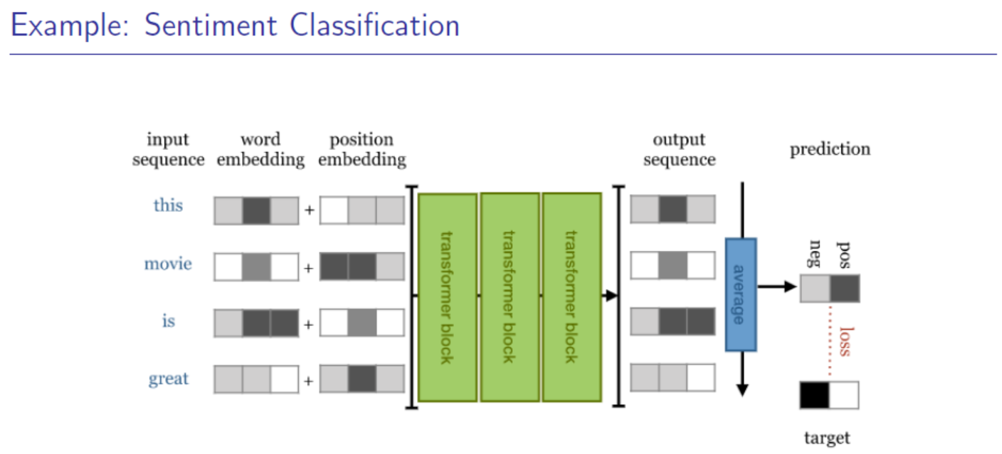

Slide 24
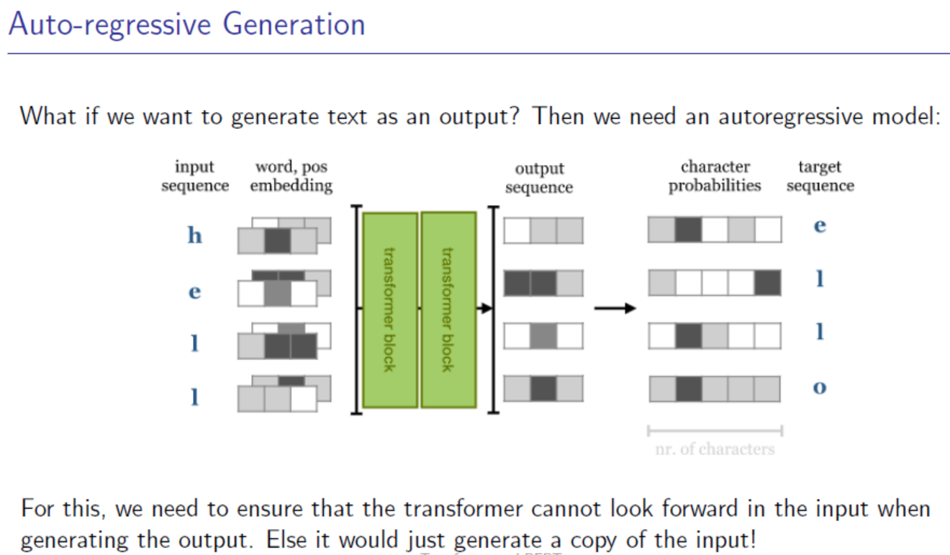

Slide 25
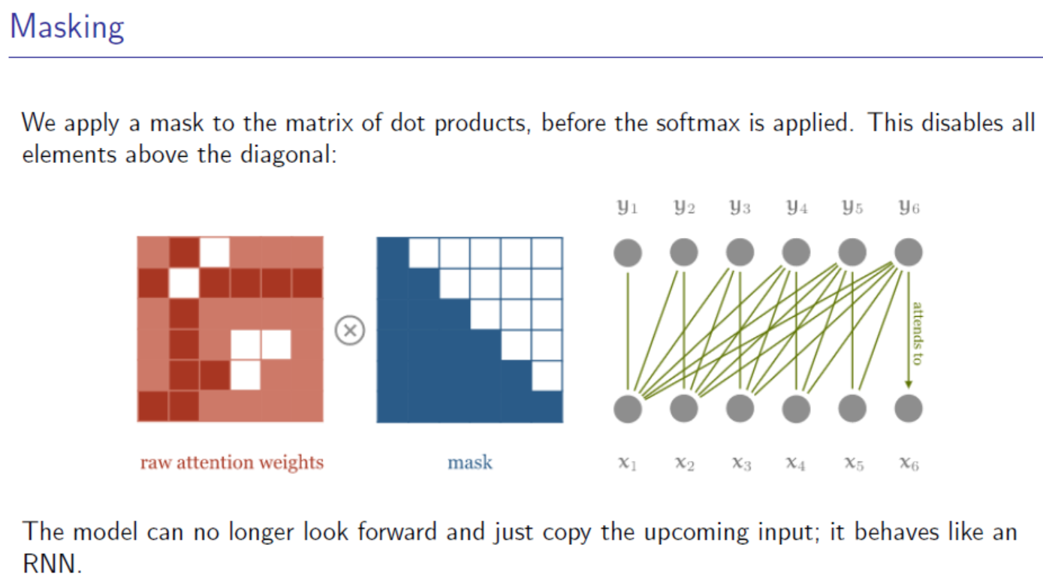

Slide 26

Figure borrowed from: https://lilianweng.github.io/lil-log/2018/06/24/attention-attention.html

Slide 27


Slide 28
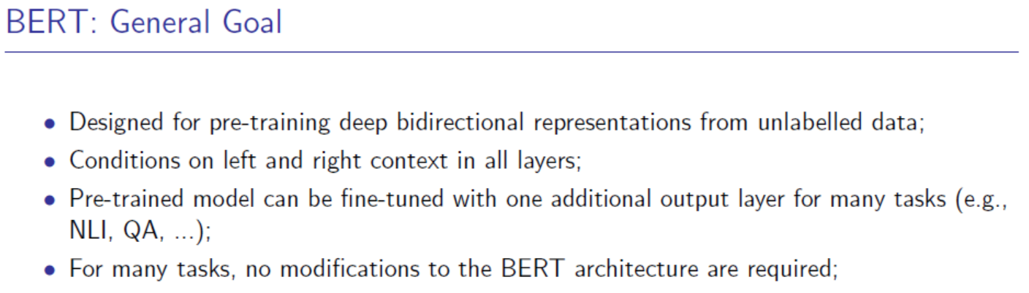

Slide 29
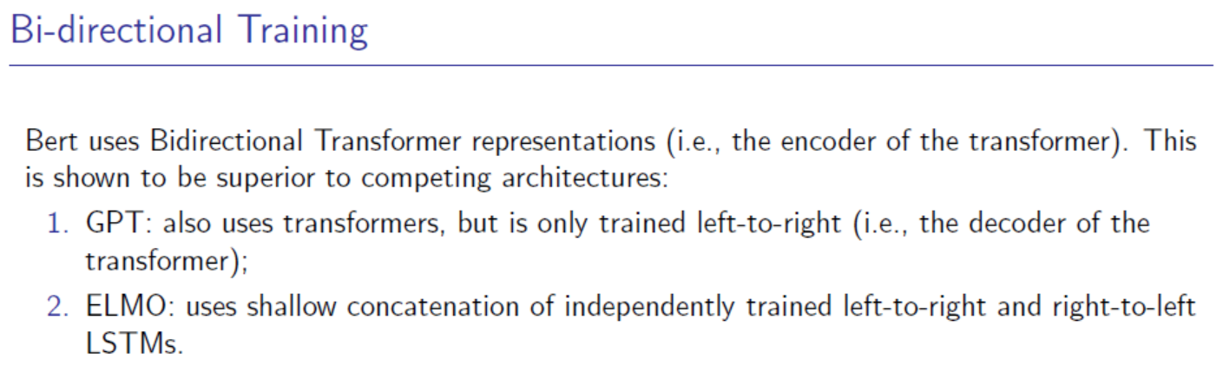
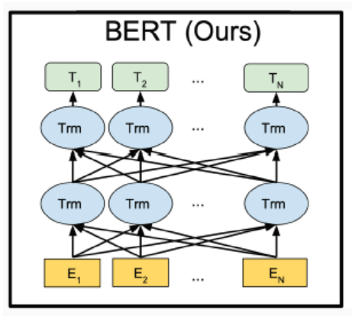
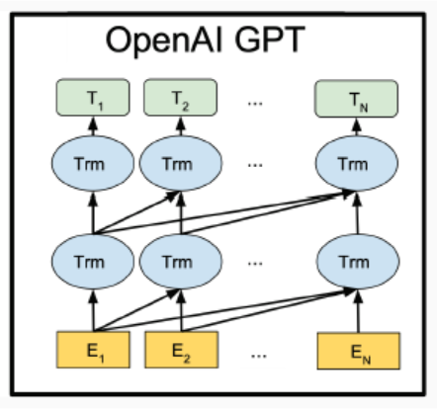
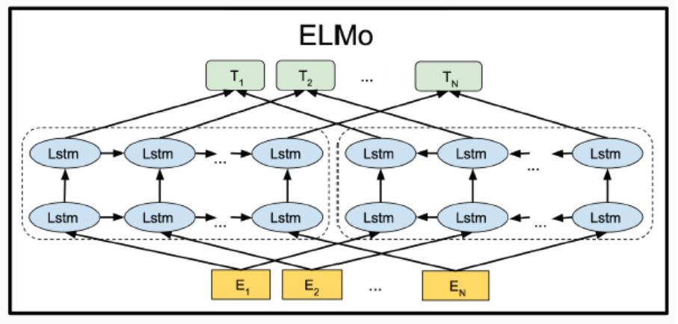

Slide 30
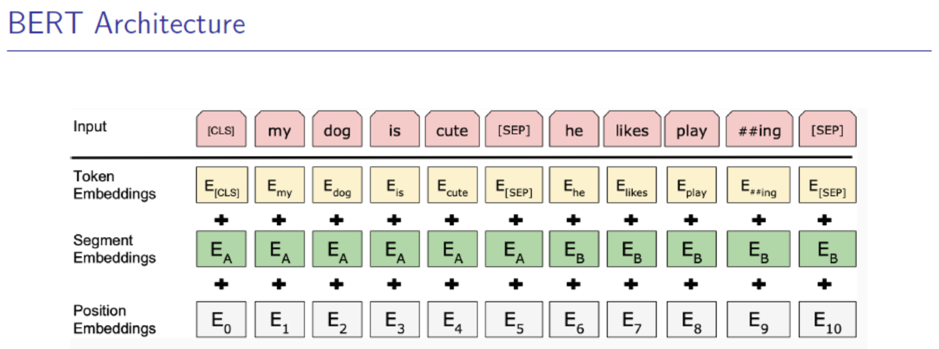

Slide 31
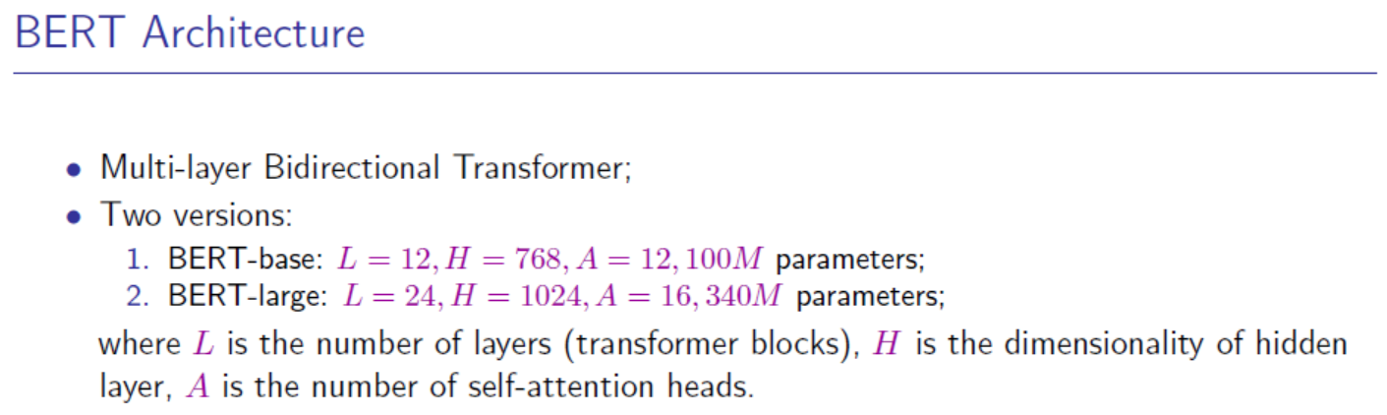

Slide 32

& Next Sentence Prediction

Slide 33
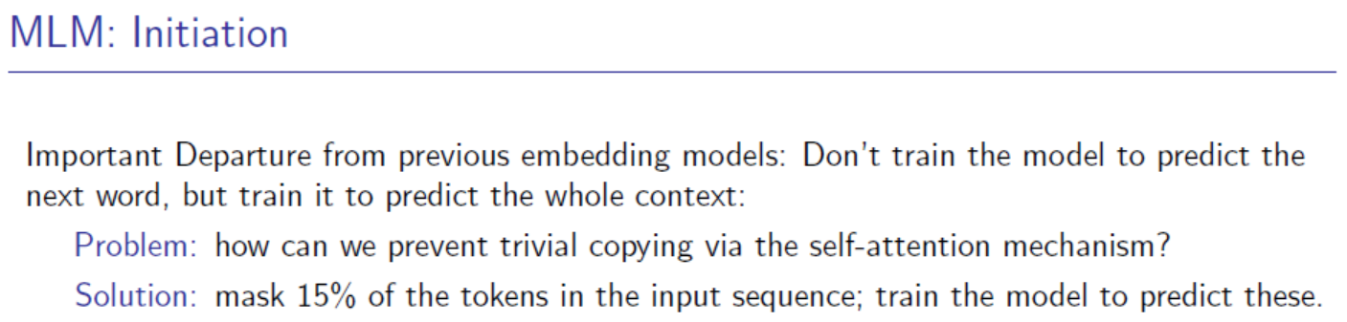

Slide 34
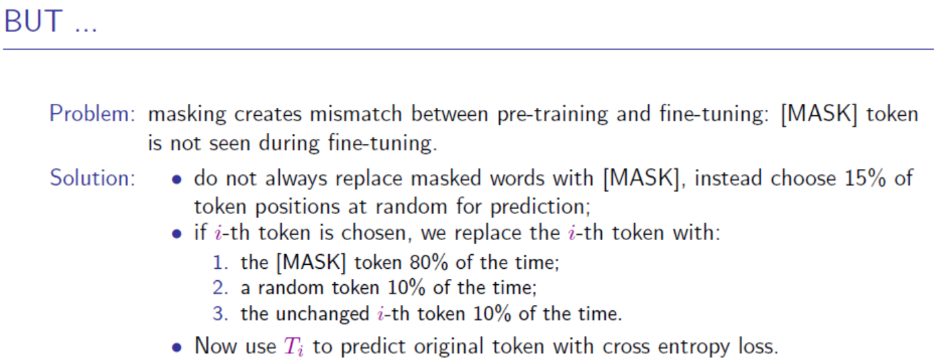

Slide 35
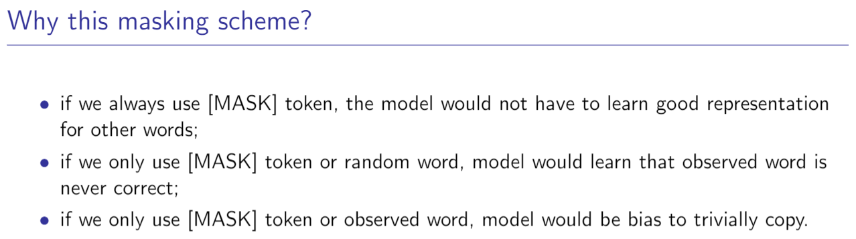

Slide 36
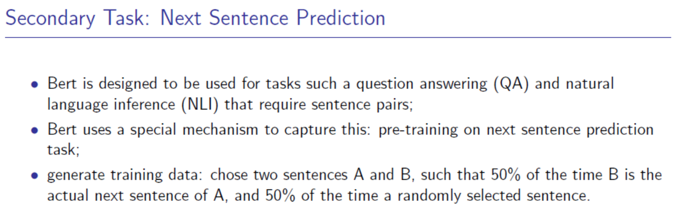

Slide 37


Slide 38
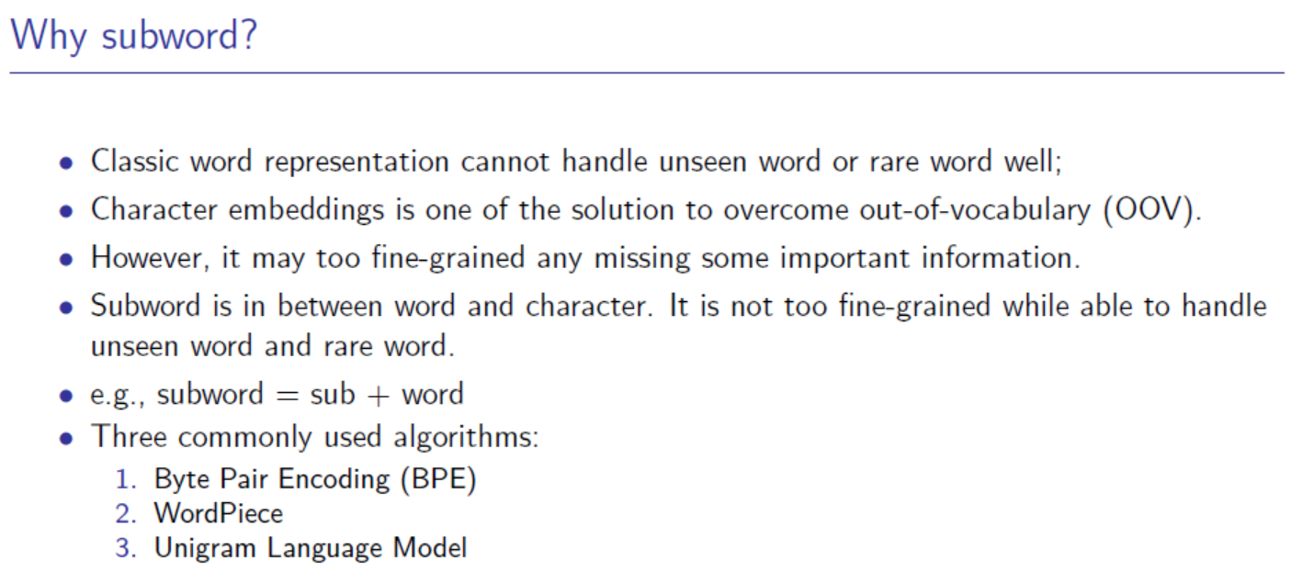

Slide 39
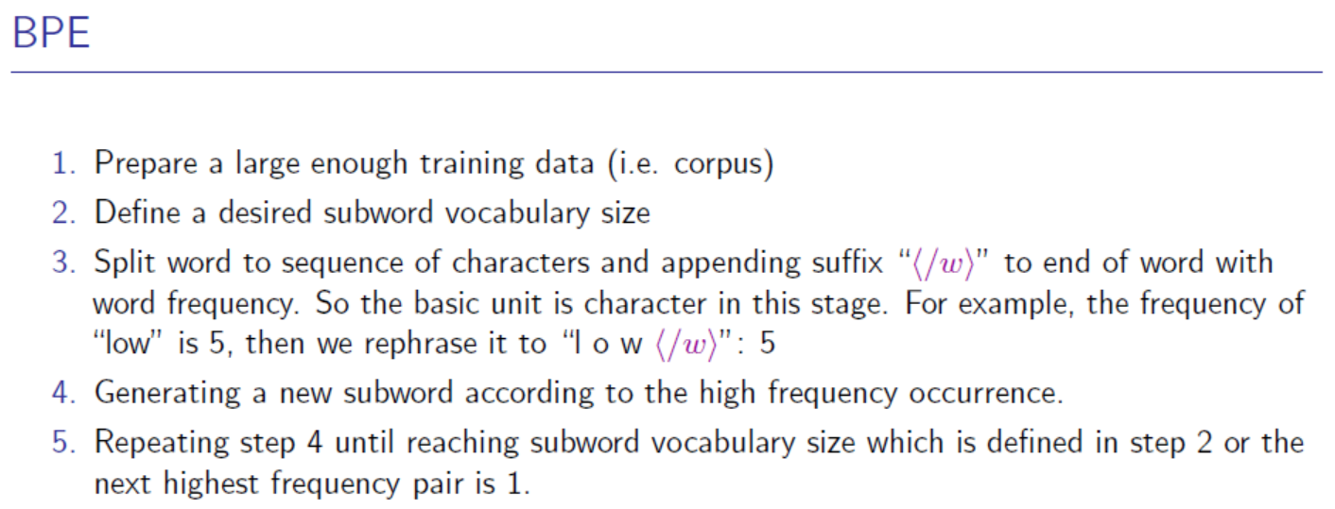
More reading:
https://blog.floydhub.com/tokenization-nlp/
https://zhuanlan.zhihu.com/p/86965595

Slide 40


Slide 41
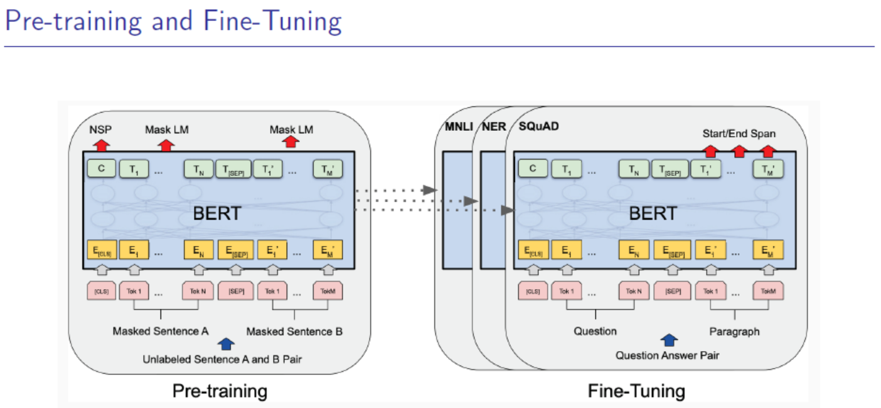

Slide 42
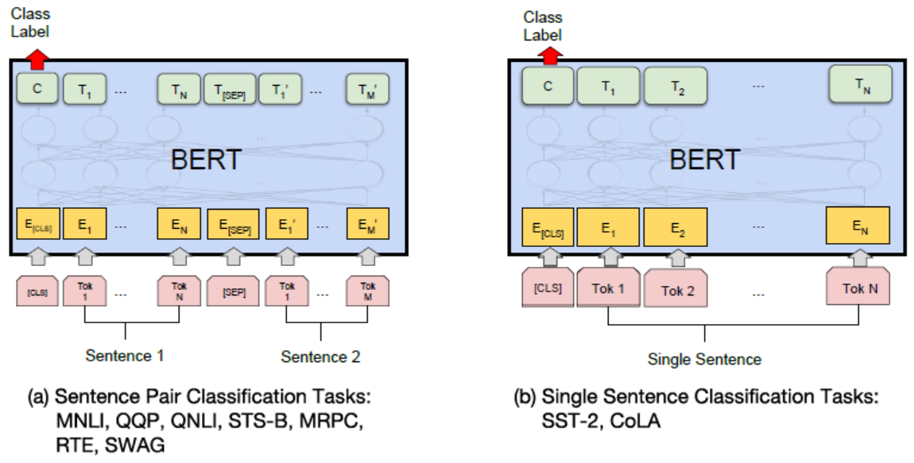

Slide 43
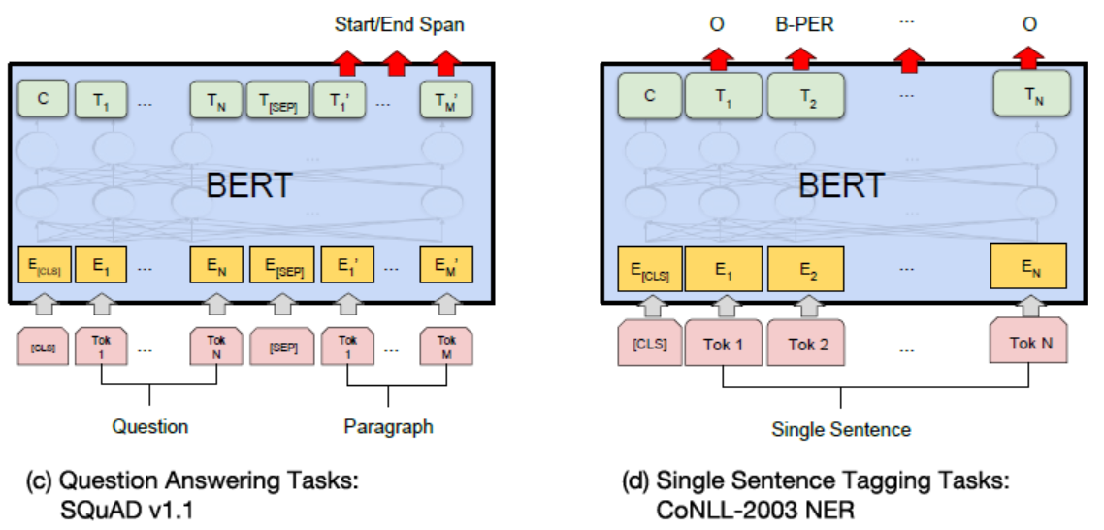

Slide 44
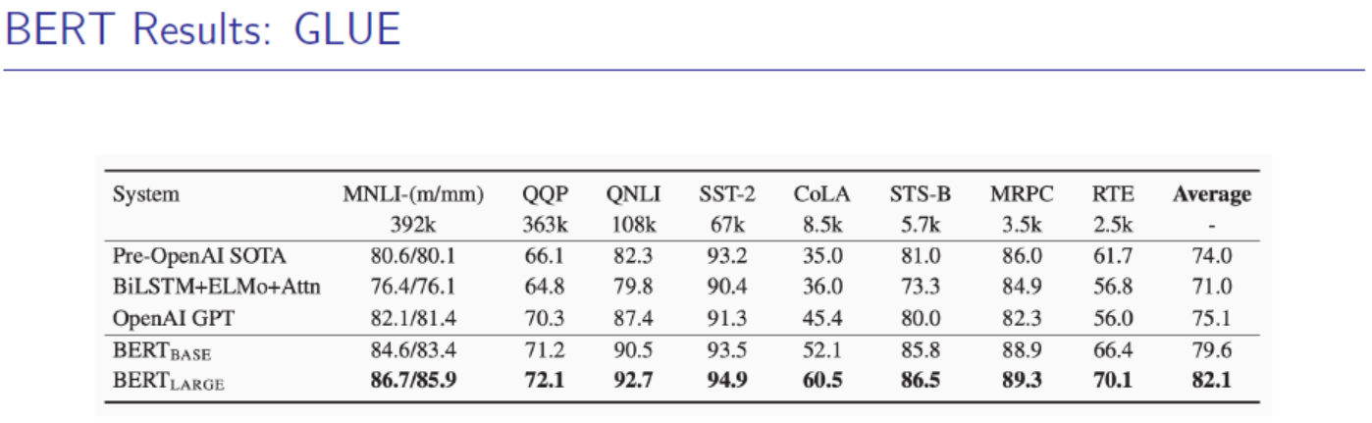

Slide 45
